Slide 1

What is Cloud Computing ?
www.netleap.co.in

Slide 2
What we are discussing in Cloud Computing now ?
Before Cloud Computing
What is Cloud Computing ?
Types of Cloud Computing
Benefits of Cloud Computing
Who uses Cloud Computing ?
www.netleap.co.in

Slide 3
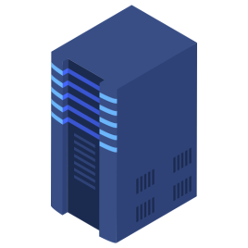


Before Cloud Computing
Company Area
Server Room
Cost
24/7 Electricity
Hardware Maintenance
Technical team maintain
Continue monitoring from software to hardware
www.netleap.co.in

Slide 4
What is Cloud Computing ?
Cloud computing is the use of a Network of remote servers hosted on the internet to store, manage and process data rather than a local server or Personal Computer
www.netleap.co.in

Slide 5
Pay only what you use
Servers, Databases, Networking, Software, etc.
Storing or accessing your data over the internet
Cloud Computing
www.netleap.co.in

Slide 6
Benefits of Cloud Computing ?
Speed
Big amount of resource can be easily available in minutes
Cost
Less expenses on hardware and software
Scalability
Easy to scale or update Cloud capacity
Accessibility
Easy to access data anywhere
www.netleap.co.in

Slide 7
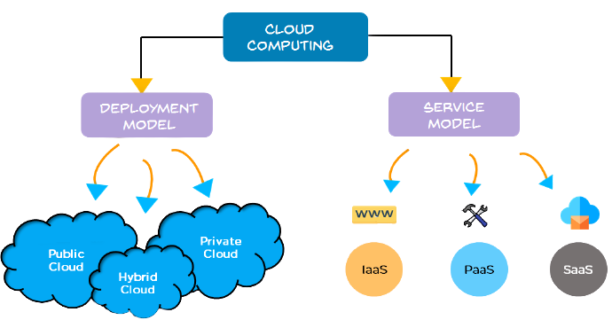
Types of Cloud Computing ?
www.netleap.co.in

Slide 8
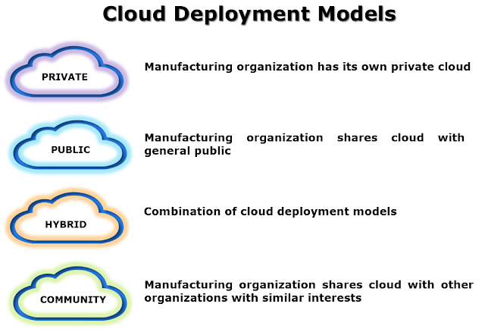
Deployment Cloud Models
HPE, DELL, ORACLE, |RedHat, etc
AWS-VPC, AZURE-AzureStack
AWS, Microsft Azure, Google Cloud Plat, Alibaba, etc
www.netleap.co.in

Slide 9
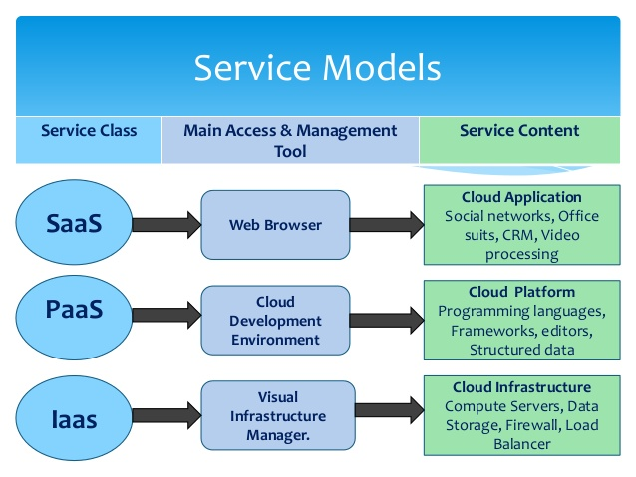
www.netleap.co.in

Slide 10
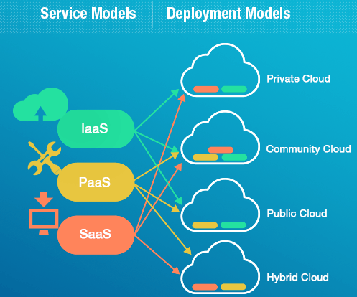
www.netleap.co.in

Slide 11
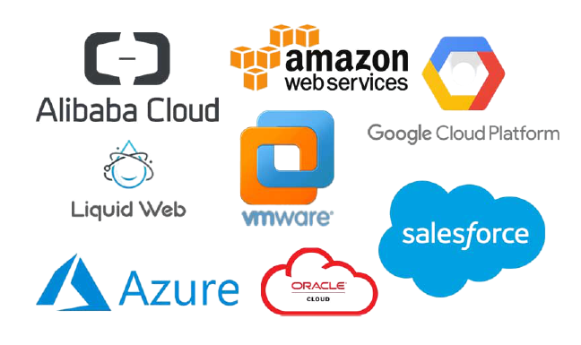
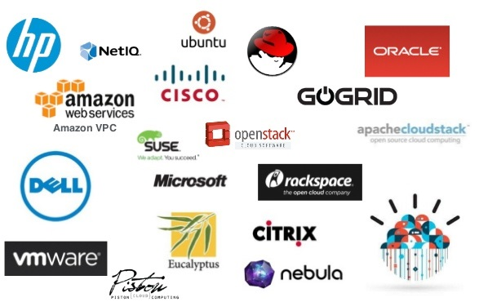
Top Cloud Service Providers
Public Cloud Providers→
←Private Cloud Providers
www.netleap.co.in

Slide 12
Why AWS
Cost Saving
Scalable & Adaptable
Security
Location, Location, Location
Automated Multi Region Backups
Streamlined Disaster Recovery
Consistency & Reliability
Simple Automated Scheduling
Pay-As-You-Go Pricing
Customization
Third Party APIs
& Lots of Services…………..
www.netleap.co.in

Slide 13
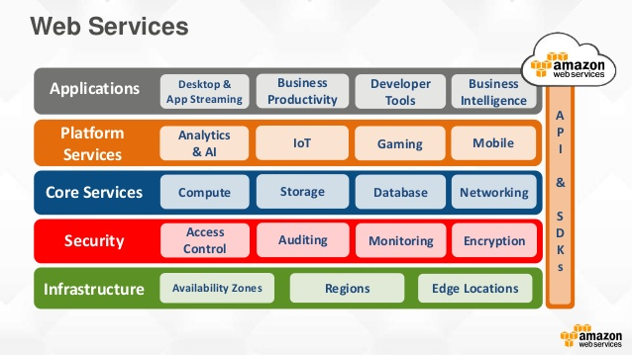
www.netleap.co.in

Slide 14
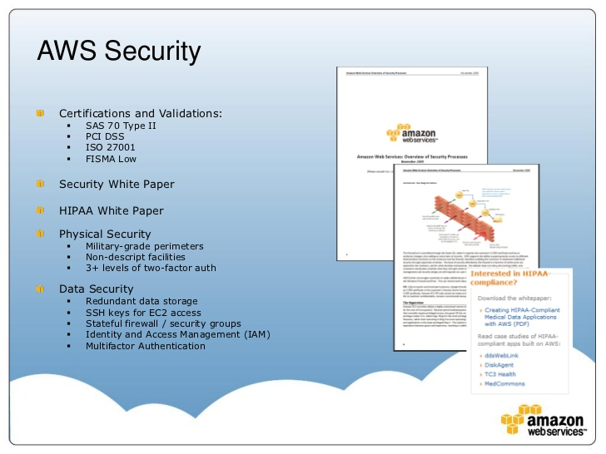
www.netleap.co.in

Slide 15
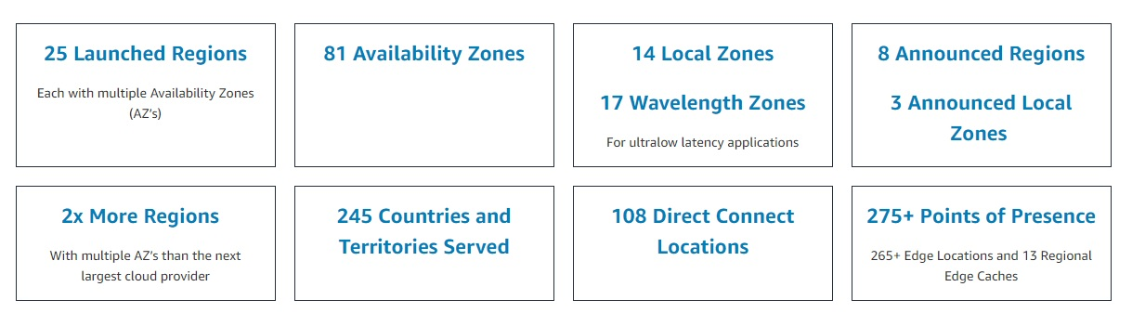
AWS Global Infrastructure
www.netleap.co.in

Slide 16
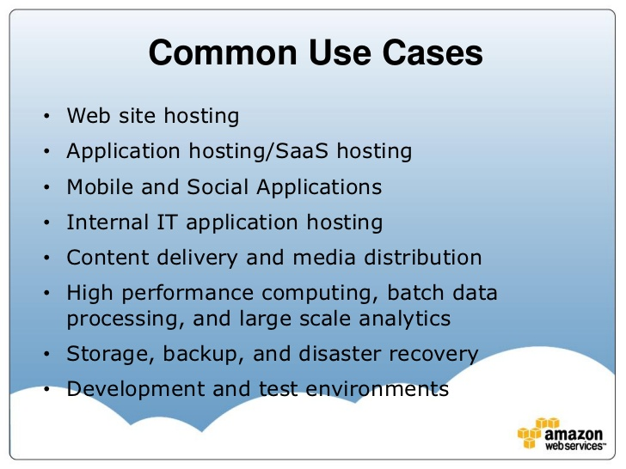
www.netleap.co.in

Slide 17
Enterprises Use Cases on AWS
Enterprise Apps and Dev./Test
Storage, Backup and Archival
Big Data
Web, Mobile, and Social Apps
Disaster Recovery
Virtual Desktops
www.netleap.co.in

Slide 18
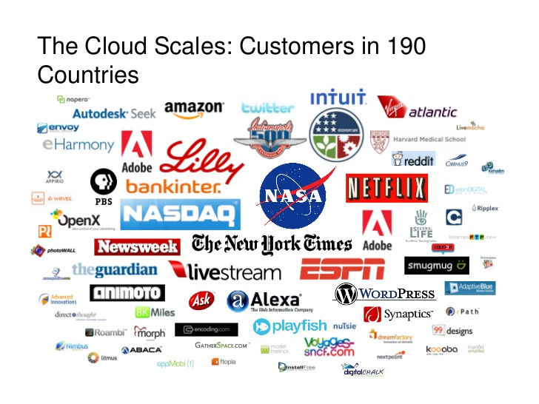
www.netleap.co.in

Slide 19
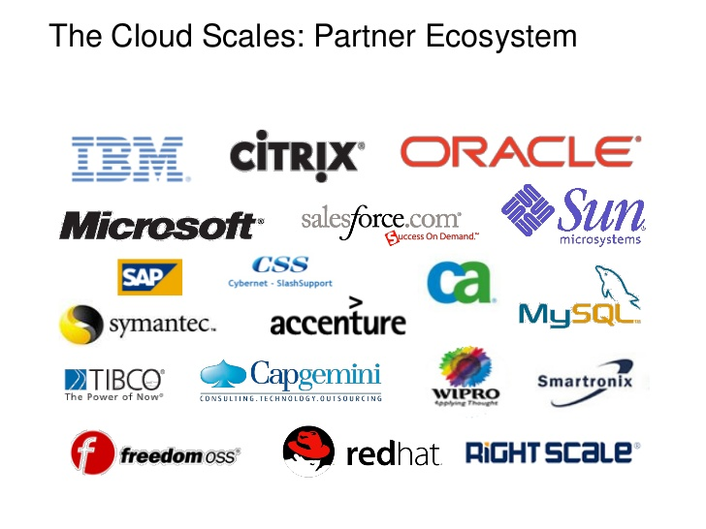
www.netleap.co.in

Slide 20
Advantages of AWS Cloud
Lower Computer Costs / IT Devices
Improved Performance
Reduced software costs
No worry about software updates or patch updates or any update
Unlimited Storage capacity
Increased data reliability
Universal access
Device independence
www.netleap.co.in

Slide 21
Disadvantages of AWS Cloud
Requires constant internet
Limitations of EC2 instances to region to region
Security Limitations on some features
No free Technical Support
www.netleap.co.in

Slide 22
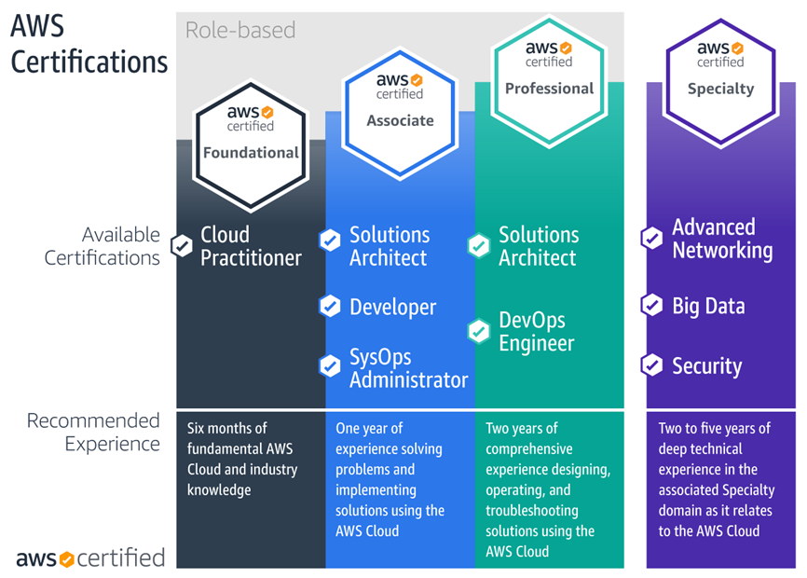
www.netleap.co.in

Slide 23
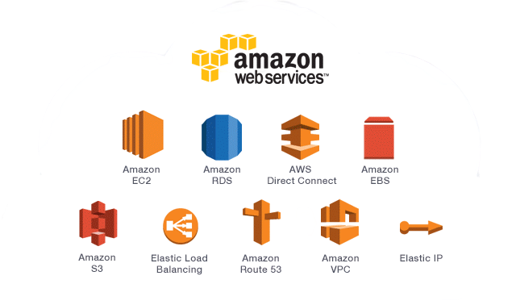
Topics Covered in AWS Solutions Architect Associate Course
www.netleap.co.in

Slide 24
If you want to become…….
In Cloud…
Cloud Developer
Cloud Support Engineer
Cloud Engineer & So on…
www.netleap.co.in

Slide 25




NetLeap Founder Members
Mrs. Mrunal Dahale
Director
(Forensic Consultant, Network, Windows Expert)
Miss. Priyanka Gaikwad
Director
(RedHat & Linux Technologies Expert)
Mr. Dinesh Chaudhari
Director
(Network & Cloud Expert)
www.netleap.co.in

Slide 26

& Visit Us – www.netleap.co.in
NetLeap IT Training & Solutions
9307338125 / 8329349481 Address – Flat No 03, Sitagufa Society, Near Vidya Vikas Circle, Gangapur Road, Nashik.
<number>

